Slide 1


Ergonomics and the Aging Workforce: Ergonomics to Retain and Manage Your Aging Workforce
Diana Schwerha, PhD
Russ College of Engineering and Technology
Ohio University
Lake County Safety Council
February 17, 2017

Slide 2
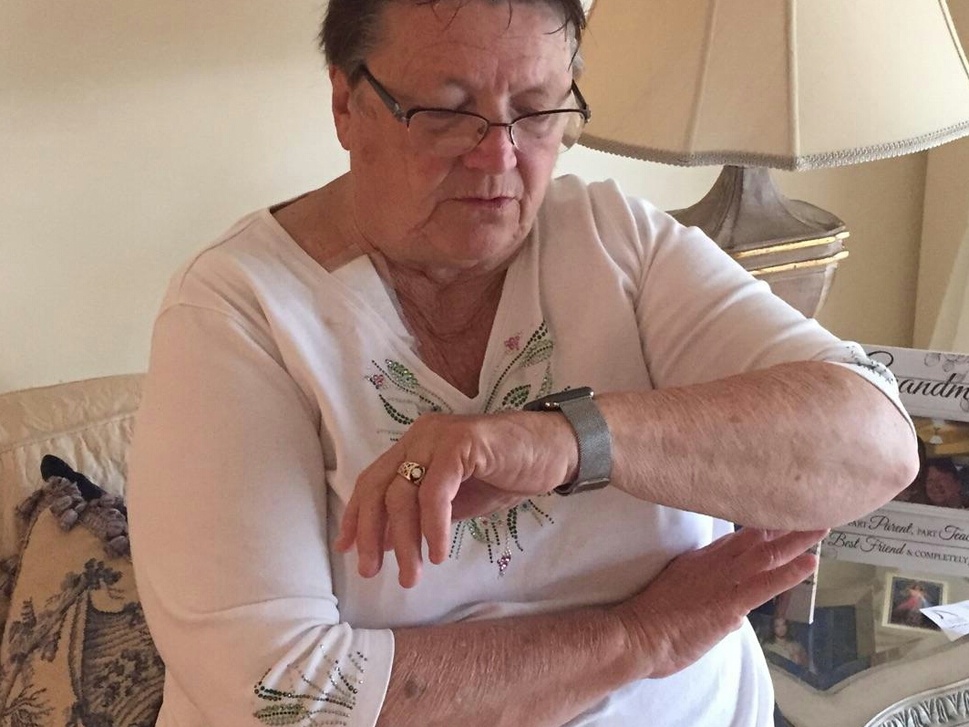
Things are changing

Slide 3
Today’s Talk
Demographics
Continuum of worker abilities
Knowledge transfer
Next Steps

Slide 4
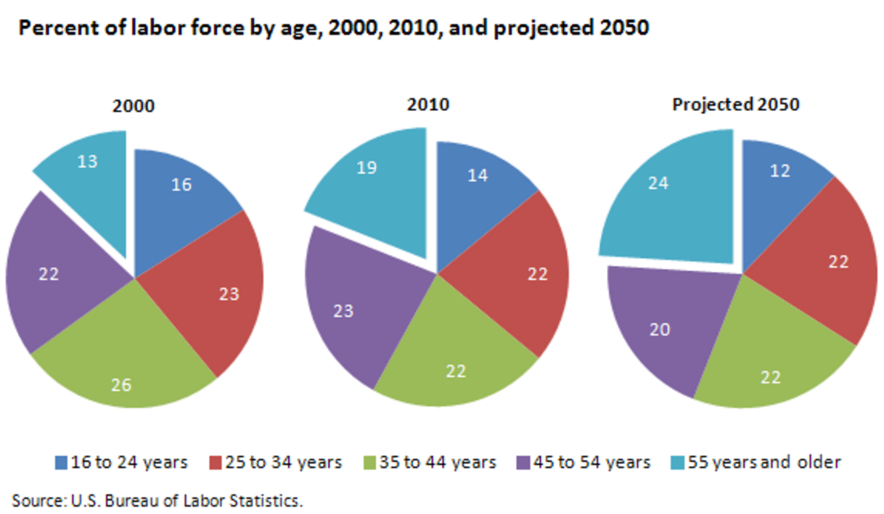
Demographics

Slide 5
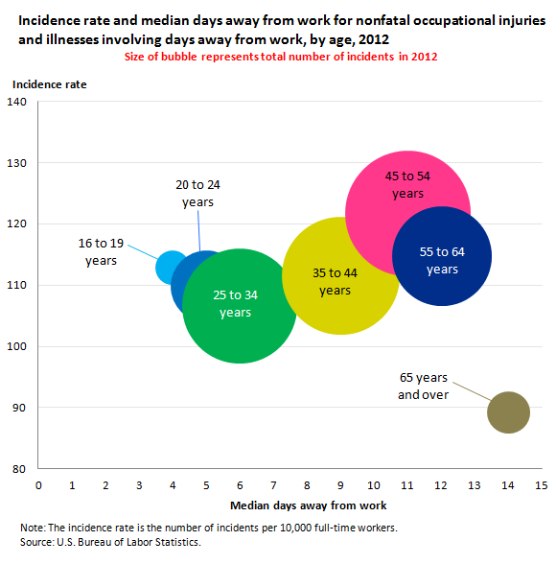

Slide 6
At your workplace
Workers may be likely to work longer
Type of work and retirement benefits are significant factors for when a person retires
Older workers may change jobs, so you may have a new employee who is older
Because older workers tend to be off more when injured, prevention is key

Slide 7
In what areas do normal age-related changes occur?
Physical
  Vision, hearing, work physiology, lifting, cold stress, reaction time, falls
Cognitive
  Stress, working memory, distraction, divided attention
Variability

Slide 8
Design tasks to match demands with worker abilities

Slide 9
Vision
Many people over 40, can’t bring close objects into focus (safety glasses)
Adapting to the dark is more difficult
Peripheral vision decreases
Decreased transmission of light
Increased problems with glare

Slide 10
Consider older adults’ vision as noisier—we must boost the signal
Increase the size of the font
Ensure enough contrast
Use sans serif font
Allow users to change font size with browser software
Avoid blue on grey
Notes:
Alan Welford

Slide 11
Improve individuals’ interaction with computer interfaces
Guidelines for designing web pages for older adults:
Making your Website Senior Friendly
Font size, contrast, organization, mental models, menu levels
http://www.nlm.nih.gov/pubs/staffpubs/od/ocpl/agingchecklist.html

Slide 12
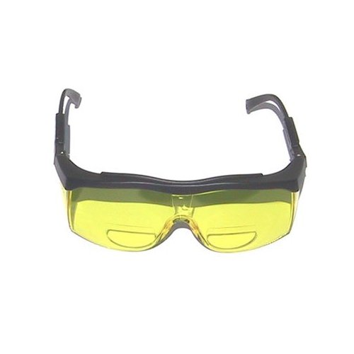
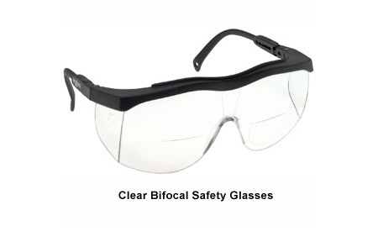
Safety glasses
http://www.amazon.com/Bifocal-Safety-Glasses-Yellow-Lens/dp/B000CCD8VY
http://www.phillips-safety.com/Bifocal-Safety-Glasses/Index.htm

Slide 13


Glare Film
http://www.tropictint.net/residential.html
http://www.hotspottinting.com/resbenefits.htm

Slide 14

Text Magnifiers or increase font size

Slide 15
Hearing
Age-related and noise induced
Men often lose ability to hear high frequency sounds (above 4000 Hz)
Noise induced hearing loss increases the problem
Additional challenges with background noise

Slide 16
Increase perception and understanding of auditory signals
Allow users to change volume
Use frequencies below 4000 Hz
For warning signals, use 500 to 2000 Hz
Use redundant signals
Minimize background noise (or at least understand where it is and how it affects performance)
Notes:
Maintain speech rates at 140 words per minute or less.

Slide 17
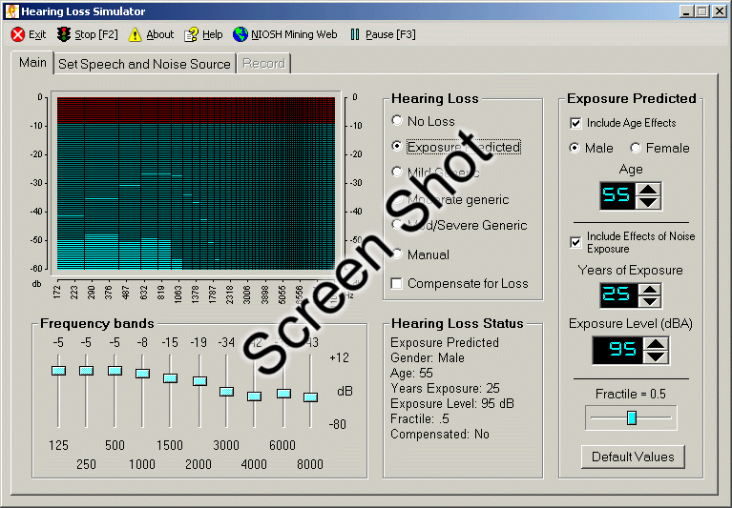
NIOSH Hearing Simulator
http://www.cdc.gov/niosh/mining/products/product47.htm

Slide 18
Work scheduling
Determine if flexible work schedules are possible
See what proportion of workers would stay if given options
Job Rotation
Watch for changing shifts (difficult as we age!)

Slide 19
Movement
Muscle mass decreases start around age 20 and continue throughout one’s lifetime
Reaction times slow
Slips and falls can be a bigger risk for older workers
Workers may adopt compensatory actions
Losses in muscle mass and strength can be partially overcome or delayed by regular weight-bearing exercise

Slide 20
Lower Back Pain
Can affect up to 80% of people during their lifetime
Back injuries have high recurrence rates ranging from 40-70%
Back injuries can result for a variety of reasons
Back injuries are expensive and have a high social cost (but you already know this!)

Slide 21
Rely on good design for lifting tasks
Heavy lifting jobs should be evaluated for all ages of workers
Mechanical assists should be used to help all ages of workers
If you can’t minimize weight, make it too heavy to lift
Ask suppliers for boxes with better coupling
Don’t give the heavy lifting to the younger people!!!!
  Risk of injury with inexperience
  Younger workers today are tomorrow’s older workers

Slide 22
Hand Tools and Grip Strength
Preventive maintenance will reduce forces needed
Changes in grip strength could be a sign of an injury
Job rotation so that different muscle groups are used

Slide 23
Identify risks for slips, trips, and falls
Locate transition areas (going from light to dark, or from dry to wet) involve higher risks for falls
Because workers change their gait according to environmental conditions, warning signs can be valuable
Investigate safety footwear (tread and additional friction devices)
Investigate alternate walkways

Slide 24
Aerobic capacity
Older workers tend to lose aerobic capacity before strength
Aging workers may have complications due to multiple conditions (obesity, high blood pressure)
Especially important with heat stress
Wellness programs may help

Slide 25
Job Design and Fatigue
In our preliminary research findings, at least half respondents stated that they are both mentally and physically tired by the end of the day
Excess fatigue could lead to burnout
Burnout is a retention issue

Slide 26

Knowledge Transfer

Slide 27
Most companies are at risk for lack of good programs to ensure knowledge transfer
Have you done a knowledge transfer audit?
Do you know where your gaps are?
What types of knowledge transfer programs do you have in place?
  Good work procedures, documentation?
  Mentoring?
  Or none, all knowledge is tribal…

Slide 28
Next Steps: Things to Consider
Injury and Near Miss Audit
  Where are your injuries or near misses occurring?
  In which age groups?
  In which tenure?
Safety Involvement
  Safety teams, Age-diverse? Experience diverse?
Consider the work environment holistically
  Safety integrated with process improvement
  Team involvement

Slide 29
Things to consider
Where will you have individuals retiring?
  Succession planning audit?
Where are your gaps in knowledge transfer?
  Utilize process improvement techniques to get age-diverse groups working together (e.g., lean tools)
Try new things and reward effort!

Slide 30

Resources: NIOSH

Slide 31
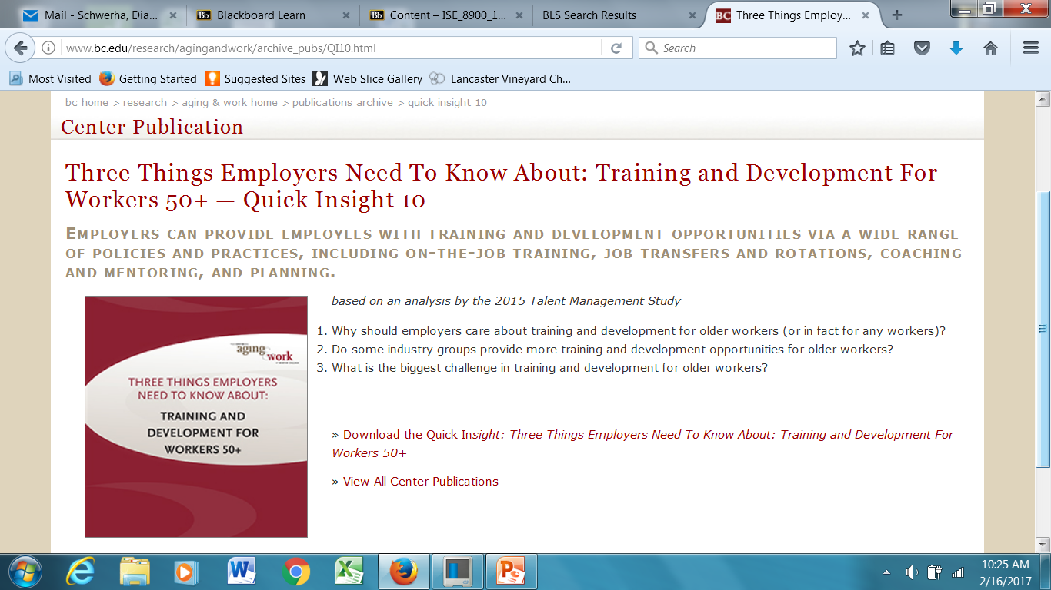
Resources: Boston Center for Aging and Work

Slide 32
Resources: Ohio University Training Modules
Aging and Ergonomics Online training
  Will be available Summer 2017
  Looking for reviewers
  Will have assessments and hoping to be able to give CEU
  Contact me at schwerha@ohio.edu for more information
Integrating Safety with Process Improvement
  Available after June 1, 2017

Slide 33

Questions?
Diana J. Schwerha, PhD
schwerha@ohio.edu
740.593.1577

